Slide 1
https://github.com/marianosz/netCoreWorkshop
Notes:
No better time to be a .NET developer – you have more scenarios at your finger tips than ever, using the technology you love and make you productive. You can literally build any app for any device for any platform with .NET.

Slide 2
.NET Core Workshop
Mariano Sánchez
sanchezmariano@outlook.com @marianosz
http://weblogs.asp.net/marianos

Slide 3





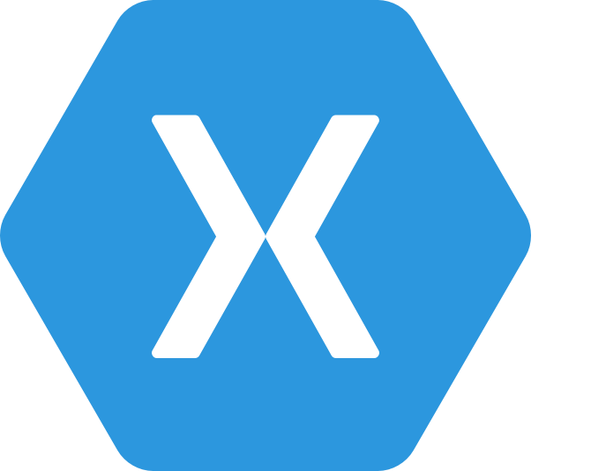
.NET Any developer, any app, any platform
iOS
OS X
Notes:
No better time to be a .NET developer – you have more scenarios at your finger tips than ever, using the technology you love and make you productive. You can literally build any app for any device for any platform with .NET.

Slide 4
.NET Runtimes
Full .NET CLR
Includes all APIS, and ensures backward compatibility.
.NET Core
Small (11 MB)
Composable, distributed via NuGET
Side by Side
Cross-Platform
Windows, OS X, Linux
Ryujit y .NET GC OSS

Slide 5
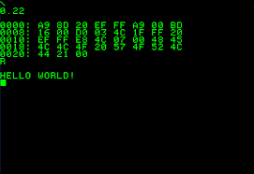



.NET Core

Slide 6
Languages
C#
Flexible, powerful, multi-purpose
Investments in C# 7: Evolve for modern patterns in distributed applications: tuples, pattern matching, others.
VB
Simple, easy to use
Investments in VB 15: Bring key language features and platforms while keeping VB simplicity principles.
F#
Elegant functional programming
Investments in .NET Core: Language updates for C# 7 / VB 15 interop, platform support and tooling updates.
Notes:
C#, Visual Basic and F# are all supported on .NET Core and can be used to create cross-platform apps that run anywhere. In addition, C# is supported in other cross-platform editors like Visual Studio Code via OmniSharp. Currently there are project templates provided C# in Visual Studio and Visual Basic templates will be added as the tooling reaches RTM (with Visual Studio NEXT).

Slide 7
Installing .NET Core
Compiling
https://github.com/dotnet/coreclr
Using Command Line
http://dot.net
Using the installer
http://dot.net

Slide 8
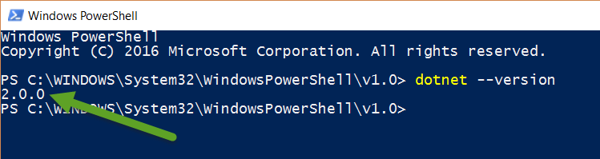
Installing .NET Core
Confirm Version:

Slide 9
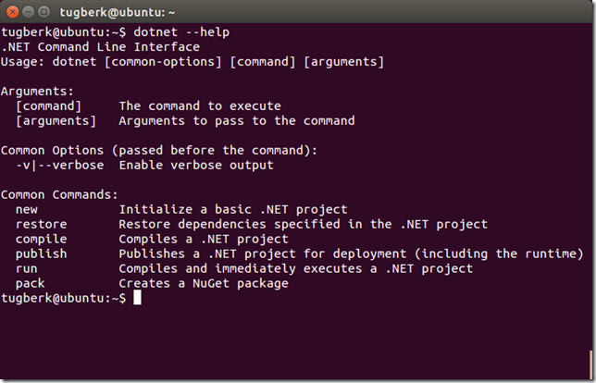
.NET Command Line Interface (CLI)
A single tool for compiling, deploying, and managing .NET applications on all platforms
Notes:
The .NET Execution Environment (DNX) is a software development kit (SDK) and runtime environment that has everything you need to build and run .NET applications for Windows, Mac and Linux. It provides a host process, CLR hosting logic and managed entry point discovery. DNX was built for running cross-platform ASP.NET Web applications, but it can run other types of .NET applications, too, such as cross-platform console apps

Slide 10
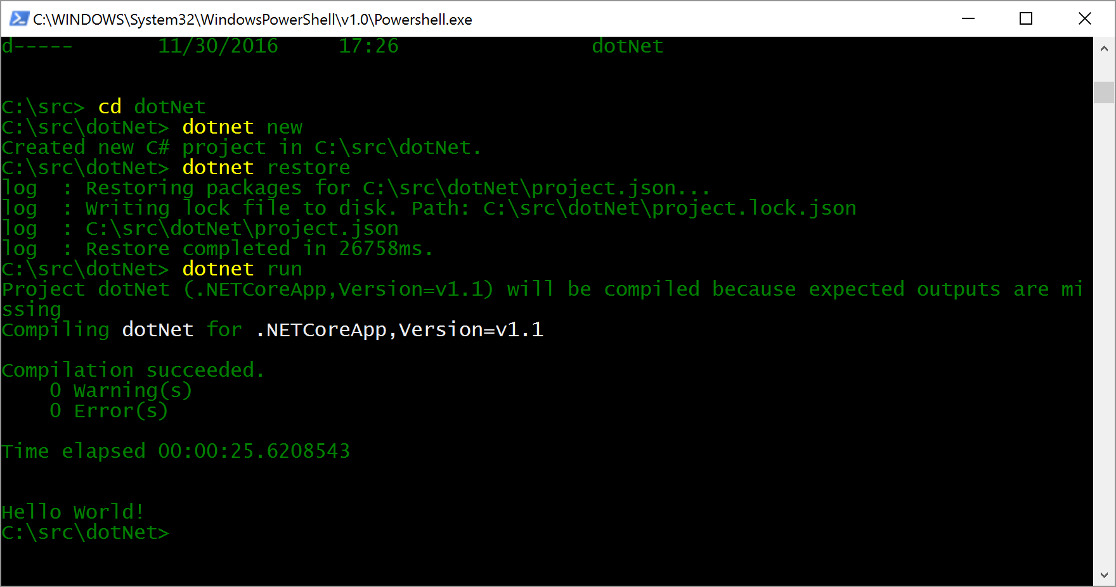
Creating and Running a .NET application

Slide 11
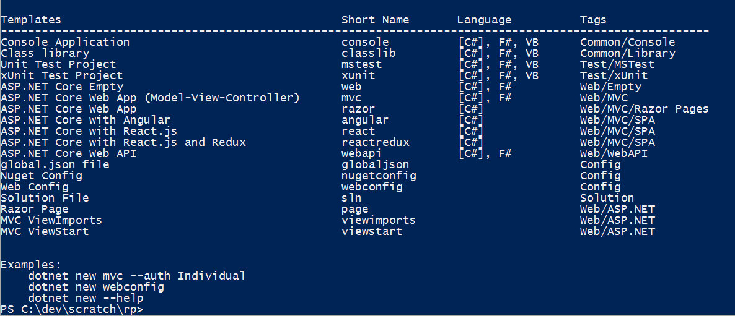
dotnet CLI Templates

Slide 12
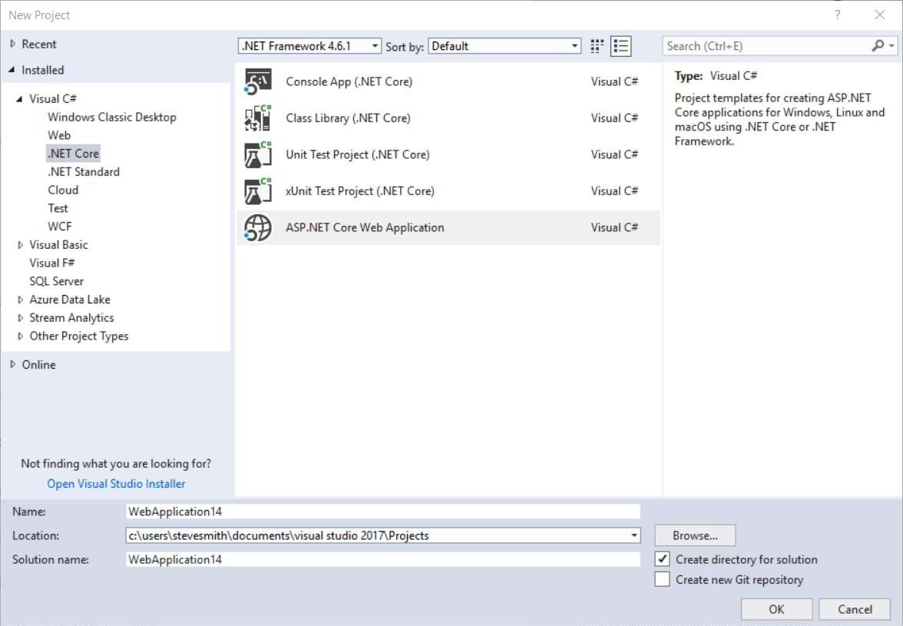
Visual Studio .NET Core Templates
Console App Class Library Unit Test xUnit Test
ASP.NET Core

Slide 13
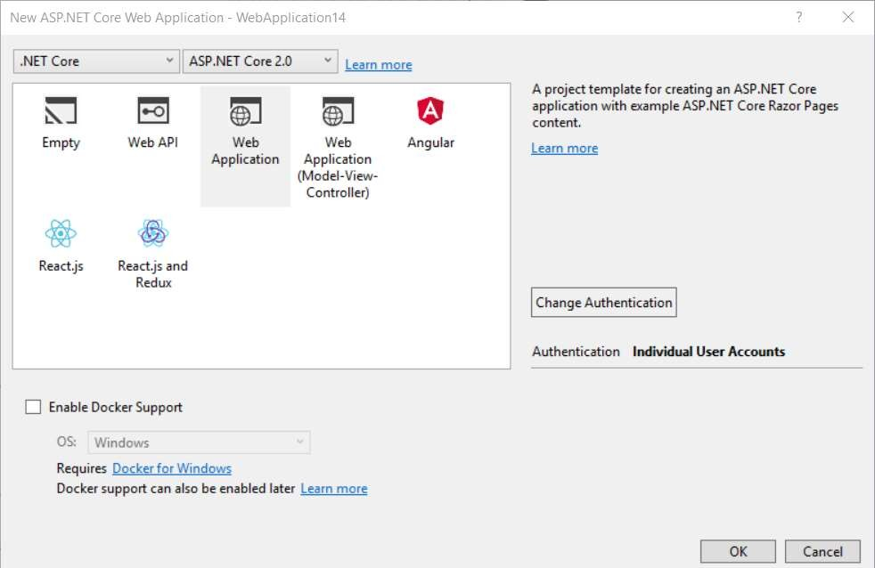
ASP.NET Core Project Templates
Empty Web API Web App
Web App (MVC) Angular
React
React and Redux
Docker

Slide 14
Development Tools
Visual Studio 2017/2019
Visual Studio
Visual Studio Code
Visual Studio Code
Other editors: Sublime Text, Atom, etc.
Other editors: Vi, Emacs, Atom, etc.
Visual Studio Code

Slide 15
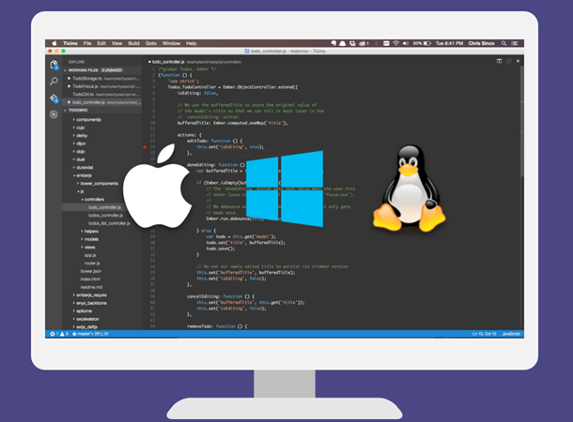
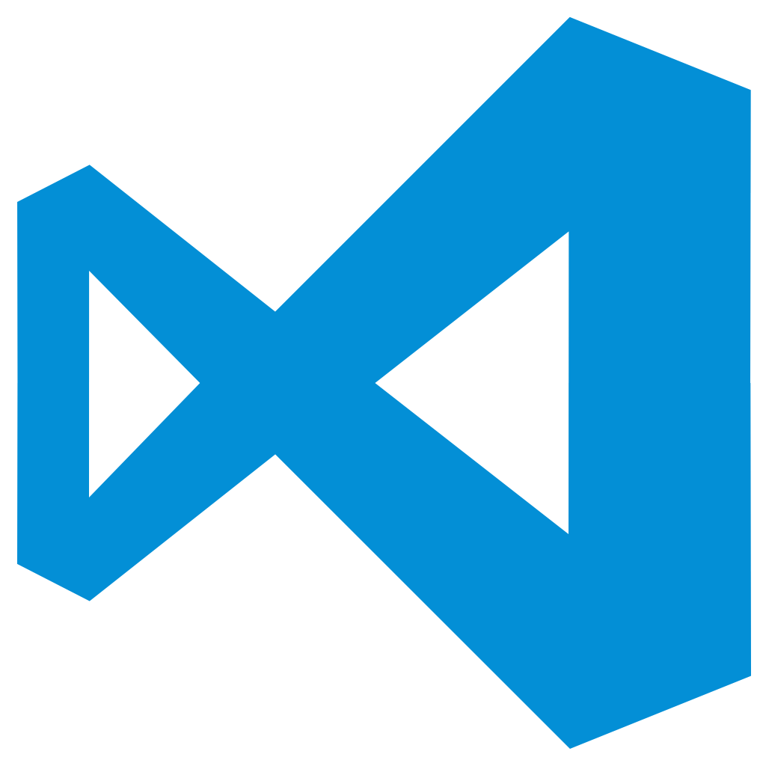
Visual Studio Code
Lightweight, cross-platform editor for Windows, OS X and Linux
With IntelliSense, colours, refactoring, etc.
Local editing, compilation, execution and debugging

Slide 16
Demo .NET Core

Slide 17
ASP.NET Core

Slide 18
ASP.NET Core
ASP.NET Core is a cross-platform, high-performance, open-source framework for building modern, cloud-based, Internet- connected applications.

Slide 19


ASP.NET Core and the modern web
Totally modular
Faster development cycle
Seamless transition from on-premises to cloud
Choose your editors and tool
Open source with contributions
OSS
Cross-platform
Fast

Slide 20
ASP.NET Core Web Server Kestrel

Slide 21
Kestrel
Open source Web server for ASP.NET
It is fast and production ready.
It is not a fully featured web server.
It is recommended that you run it behind a more fully featured webserver like IIS on Windows or NGNIX on Linux.
It is run behind IIS using the ASP.NET Core Module (native IIS module).
Maps a HTTP Request to the HttpContext.

Slide 22
Kestrel in a ASP.NET Core App
Hello world!!
Request
Kestrel
Response

Slide 23
ASP.NET Core Web App Key Components

Slide 24
Startup.cs
Constructor (optional)
ConfigureServices Configure

Slide 25
Middleware
“Middleware are software components that are assembled into an application pipeline to handle requests and responses”
Each component in the pipeline is a request delegate.
Each delegate can invoke the next component in the chain, or short-circuit, returning back up the call chain

Slide 26
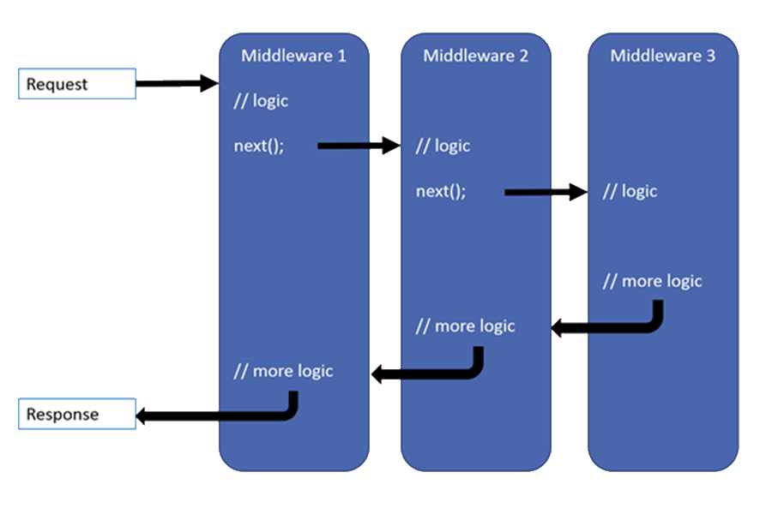
Middleware

Slide 27
Built-in Middleware
UseDeveloperExceptionPage
UseDatabaseErrorPage
UseExceptionHandler
UseStatusCodePages
UseAuthentication
UseStaticFiles
UseMvc

Slide 28
Kestrel + Middlewares
Request
Middleware
next()
Middleware
Middleware
next()
Kestrel
return
return
Response
return

Slide 29
ASP.NET Core MVC

Slide 30
Models, Views, and Controllers
What does MVC look like?
Request
Controller

Model

Response
View

Notes:
20486A
01: Exploring ASP.NET MVC 4

Slide 31
Controllers and Actions
Controllers are collections of actions
Useful for grouping actions into cohesive sets
Used by default for routing and URL generation (e.g. /{controllername}/{actioname})
Actions are methods that handle individual requests
Each request is routed to an action method

Slide 32
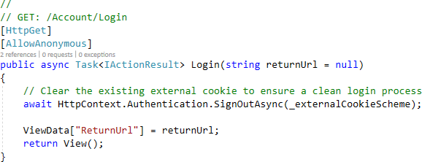
An MVC Action

Slide 33
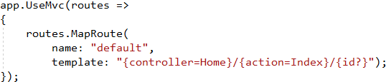
Routing to Actions
Default route specified in Startup Configure method
Attribute routing (at Controller and/or Action level)
[Route(“products/index”)]
[Route(“products/update/{id})]
[Route(“home”)] on Controller and [Route(“about”)] on Action are combined into “home/about” route

Slide 34
Attribute Routing Tips
Use default convention where possible
Define routes using attributes for non-default cases, especially for APIs APIs should use HTTP verb attributes to define routes:
[HttpGet]
[HttpGet(“{id}”)] // will combine with route specified on controller
Routes can use token replacement for [area], [controller], [action]:
[Route(“[controller]/[action]”)]
Especially powerful when used with inheritance:
[Route(“api/[controller]/[action]”)]
public abstract class BaseApiController : Controller

Slide 35
Accepting Data in Actions (Model Binding)
MVC uses model binding to convert data sent by requests into action parameters
Model binding takes place before the action is invoked
Parameters may be simple types, or complex objects
Data can come from named form values, route components, or query strings

Slide 36
Model Validation
Model types can have validation rules specified
Actions should check model validation state before making changes to application state
if(ModelState.IsValid)
Avoid using data model types for model binding
This can result in exposing more data to user changes than intended

Slide 37
Tag Helpers
Replaces HTML Helpers (still available, but not recommended)
Render within HTML tags
Declarative, not Imperative

Slide 38
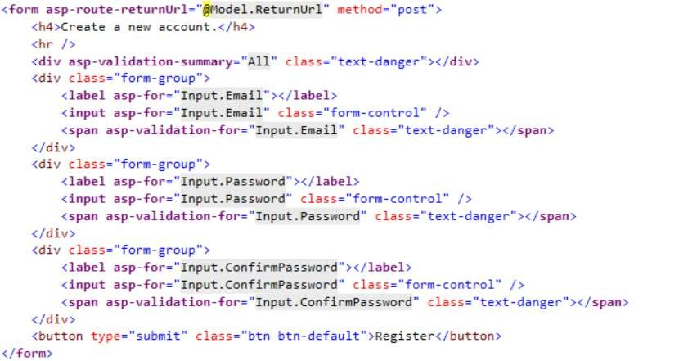
Tag Helper Example
No Cont
(Reserved fo

Slide 39
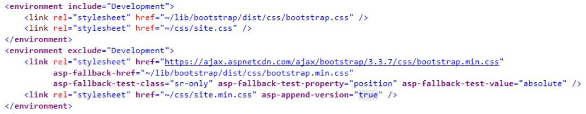
Tag Helper Example

Slide 40
Web APIs
Web API
MVC App
HTML5 App
Mobile App

Slide 41
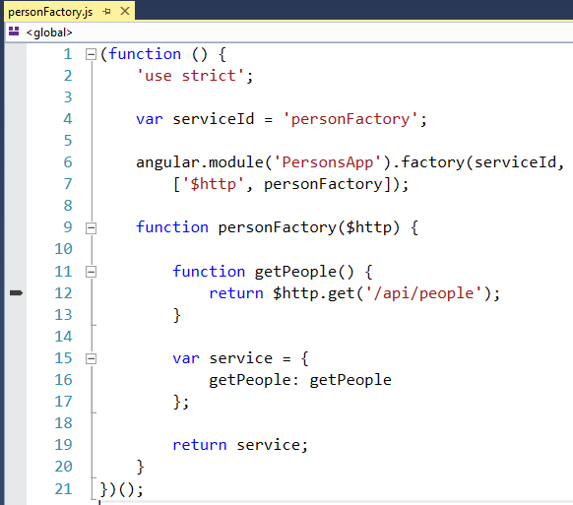
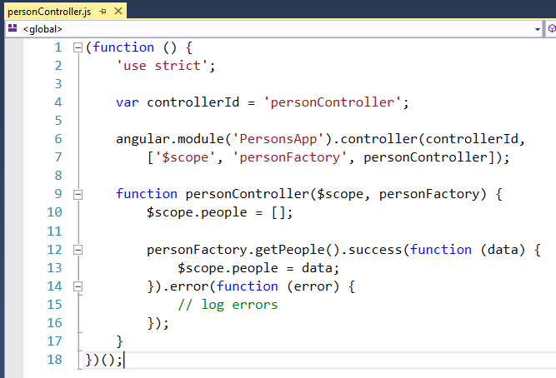
Angular App

Slide 42
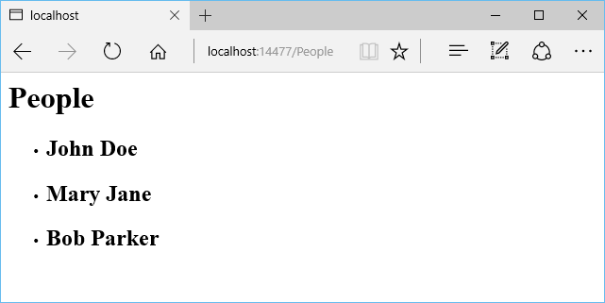
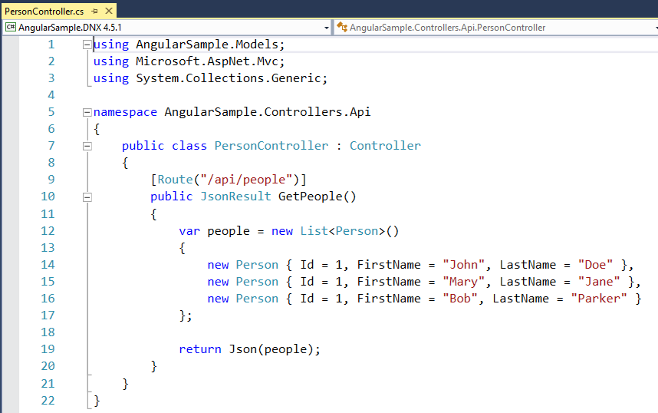
Web API Controller

Slide 43
Demo ASP.NET Core

Slide 44
¿Preguntas?

Slide 45
¡ Gracias!
Mariano Sánchez
sanchezmariano@outlook.com @marianosz
http://weblogs.asp.net/marianos

